Slide 1
VIEW OPEN SOURCE DESIGN FILES FROM SPARKFUN & ADAFRUIT

Slide 2
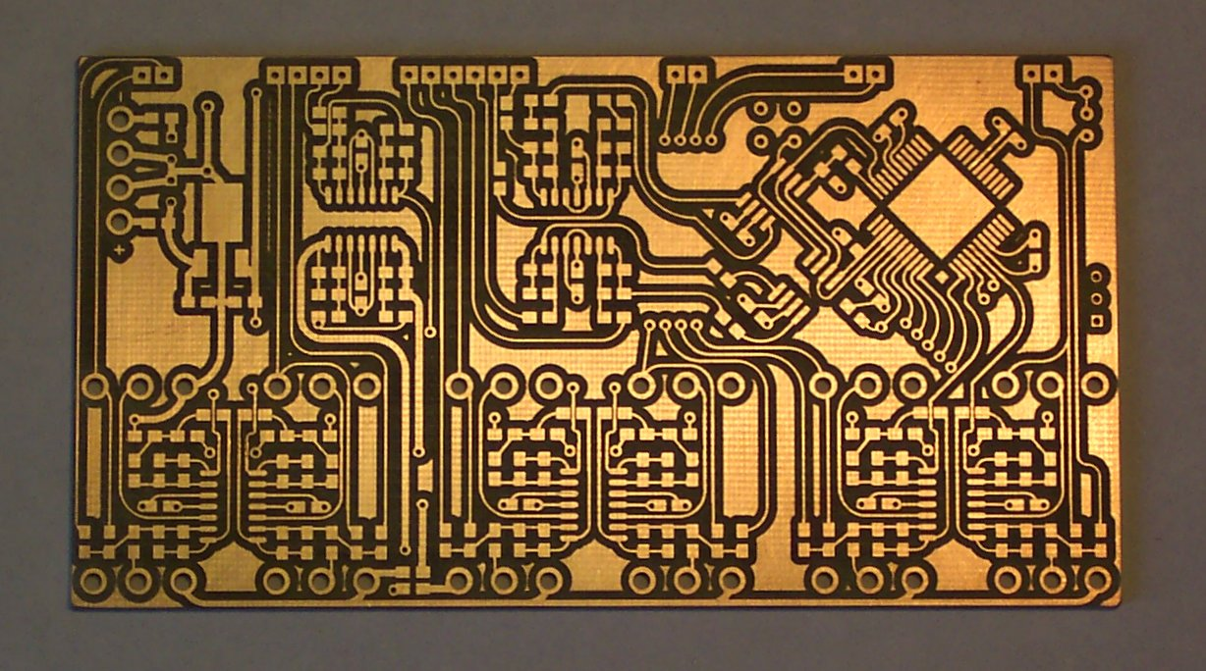

Slide 3
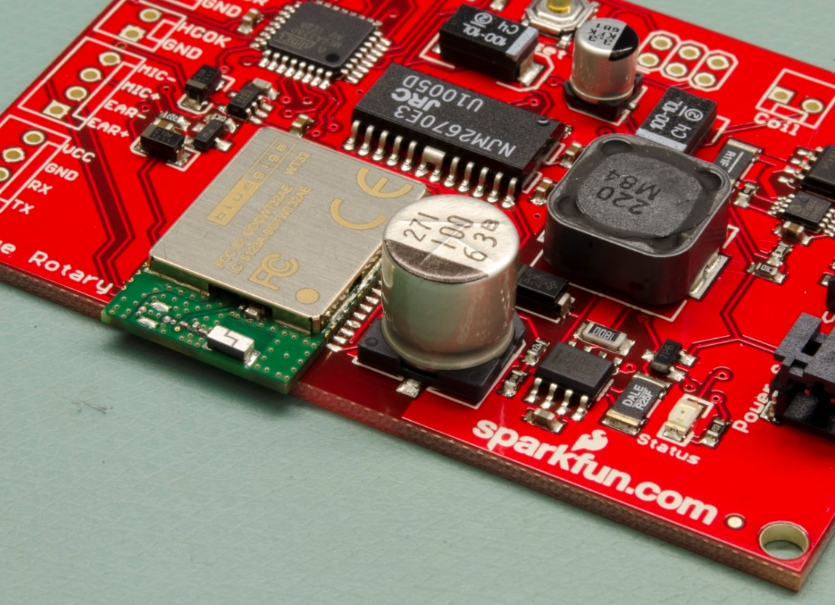
Populated

Slide 4
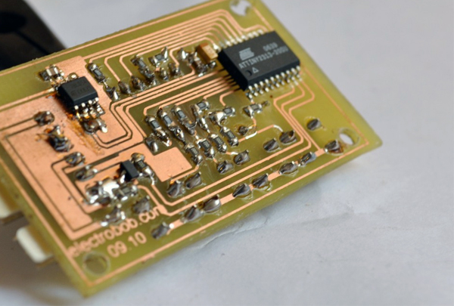
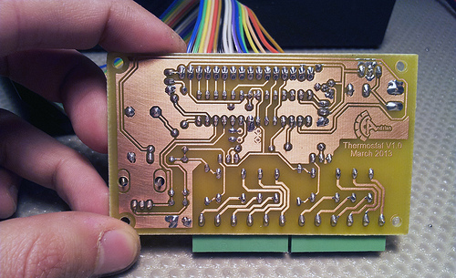
Something you can make here

Slide 5
EXPLAIN THE GUI & CONTENTS OF THE INSTALLATION FOLDERS. EXPLAIN THE VARIOUS ICONS & DOCUMENTATION.

Slide 6
COMMON TERMINOLOGY LIKE VIAS, THROUGH HOLES, LAYERS, TRACES, POLYGONS, WIRE etc.

Slide 7
TWO DESIGNS 741 AMPLIFIER AND SAMD21

Slide 8
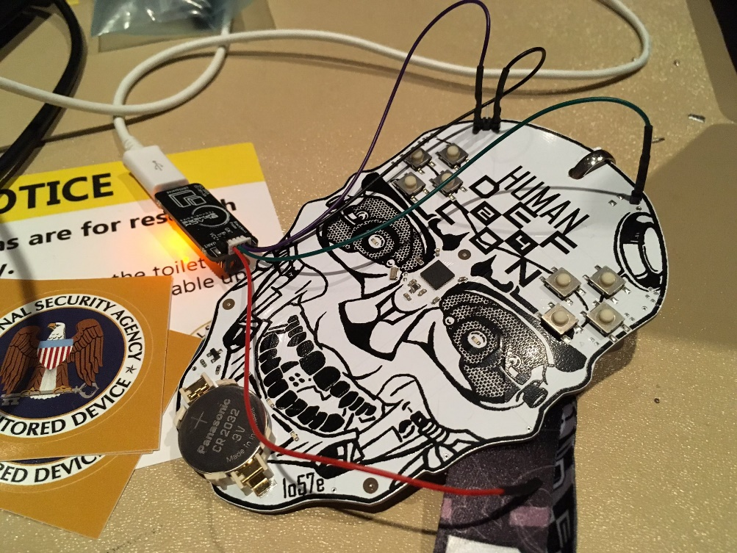
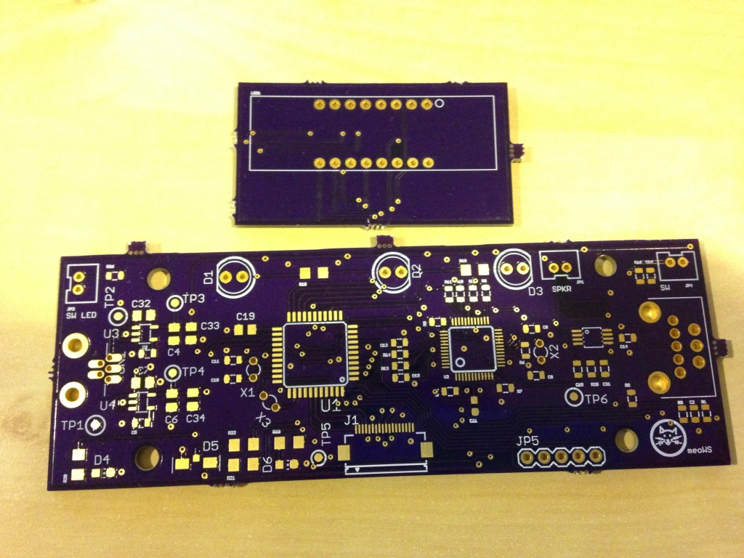
SOLDER MASK EXAMPLES

Slide 9
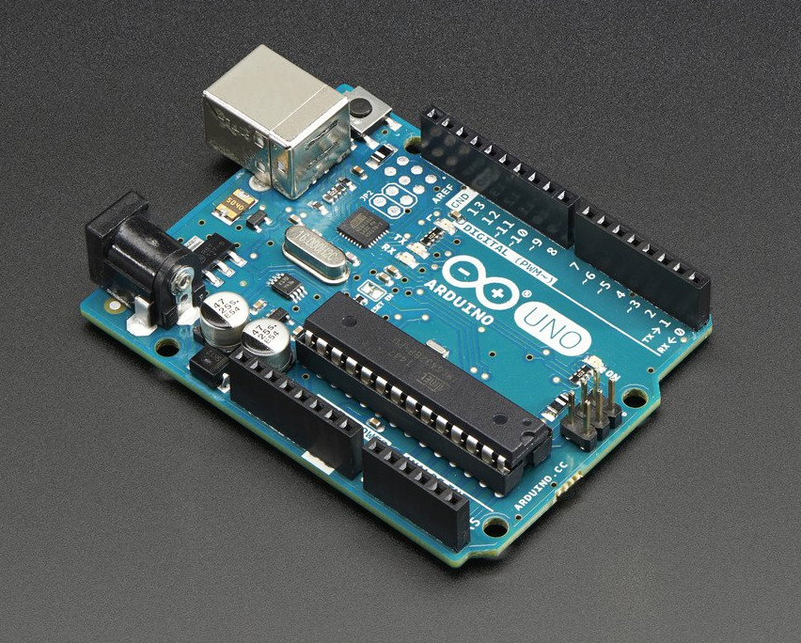
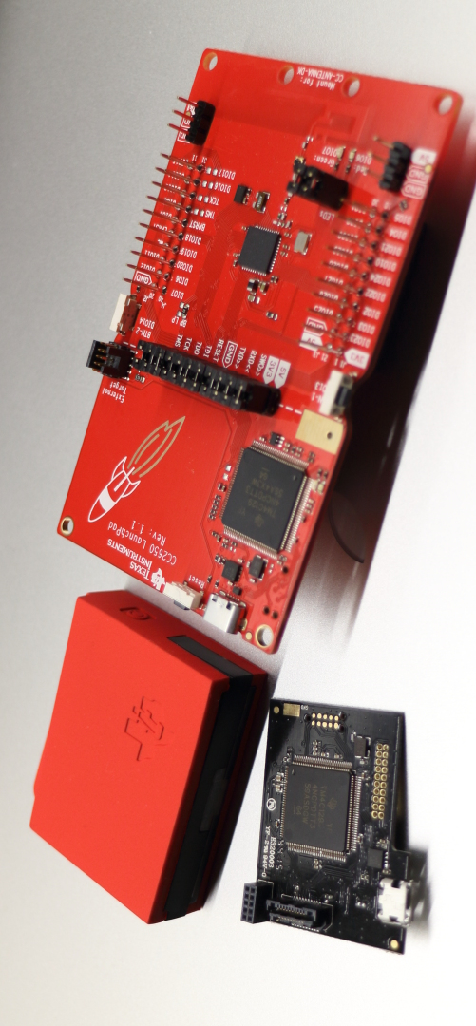
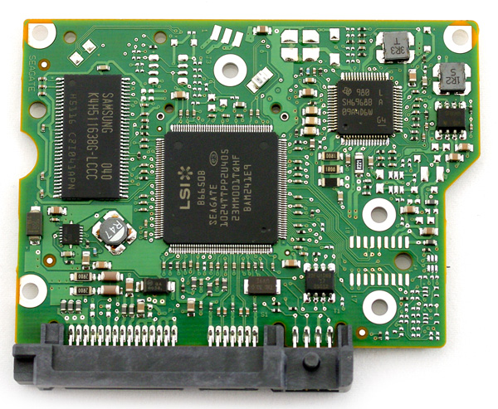

Slide 10

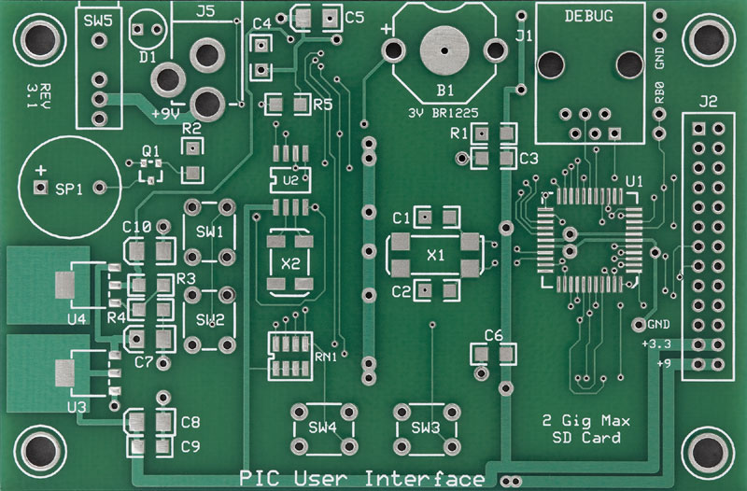
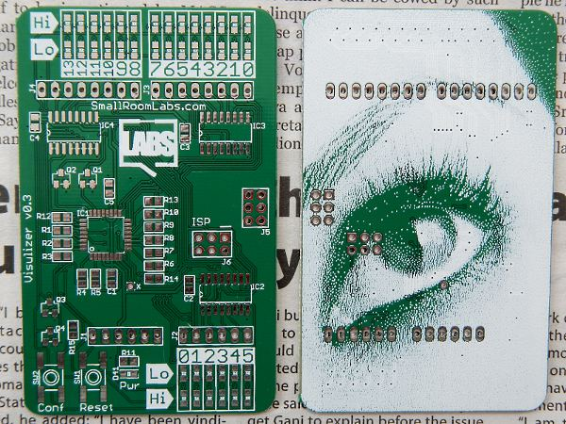
SILKSCREEN

Slide 11
GRIDS AND UNIT ISSUES, SCHEMATIC -> INCHES LAYOUT -> MM LIBRARY -> MM

Slide 12
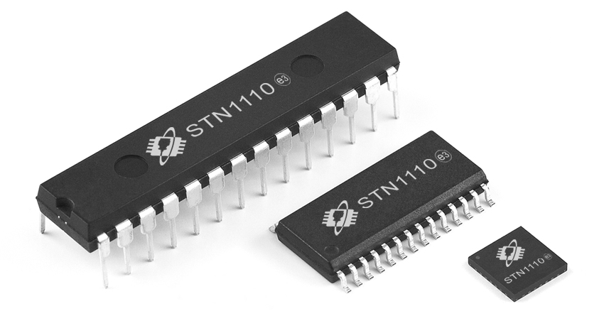
PACKAGES

Slide 13
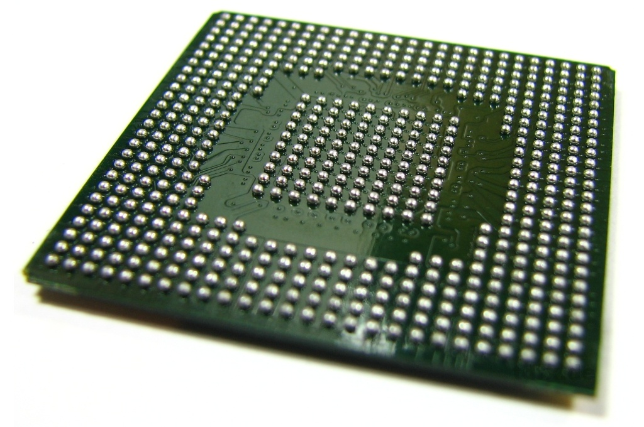
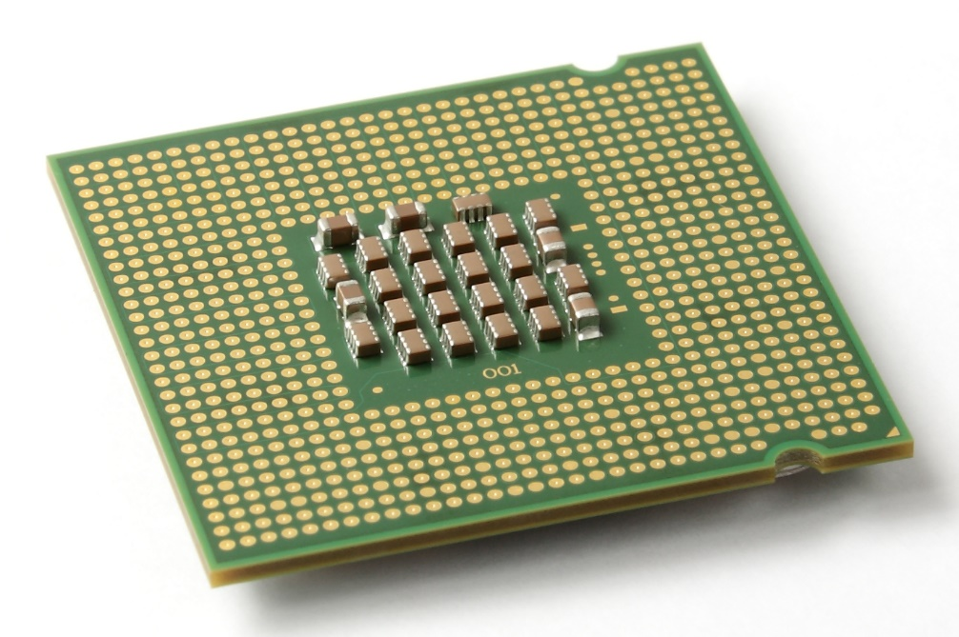
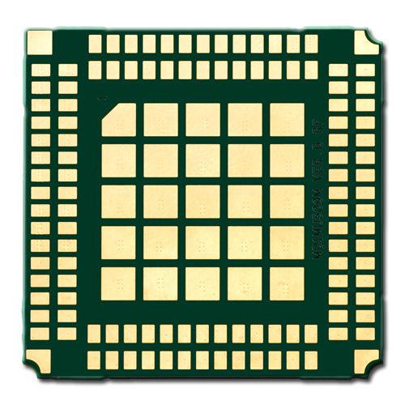
BGA and LGA

Slide 14
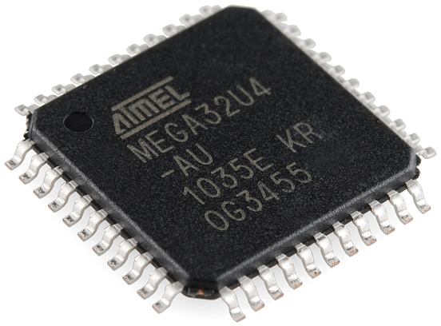
TSSOP

Slide 15
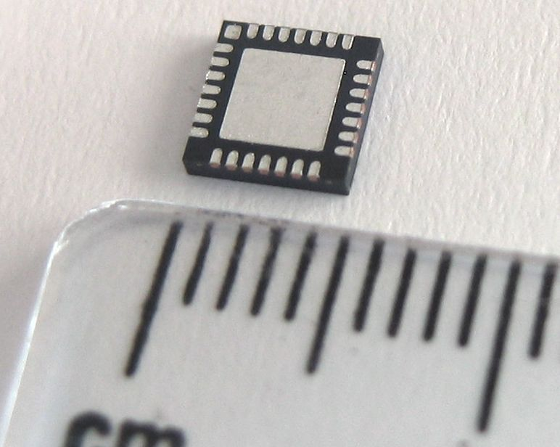
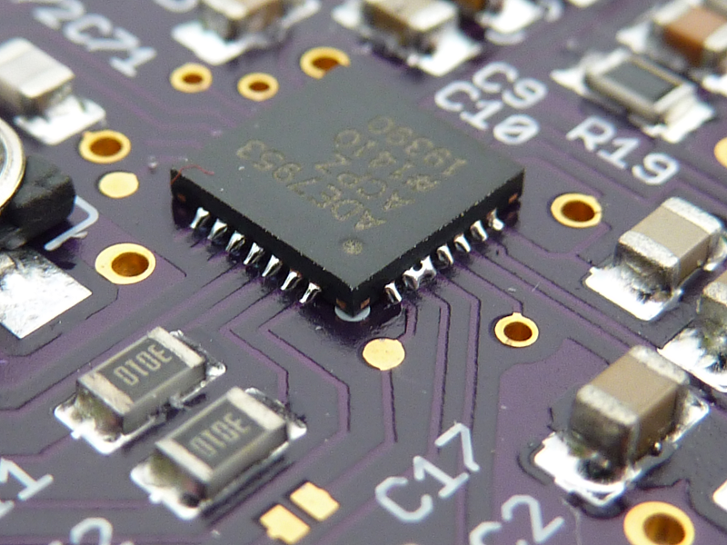
VQFN

Slide 16
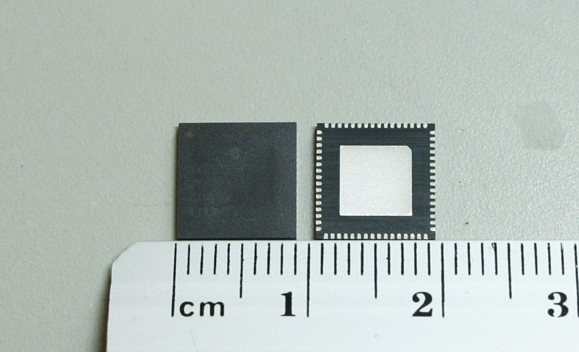
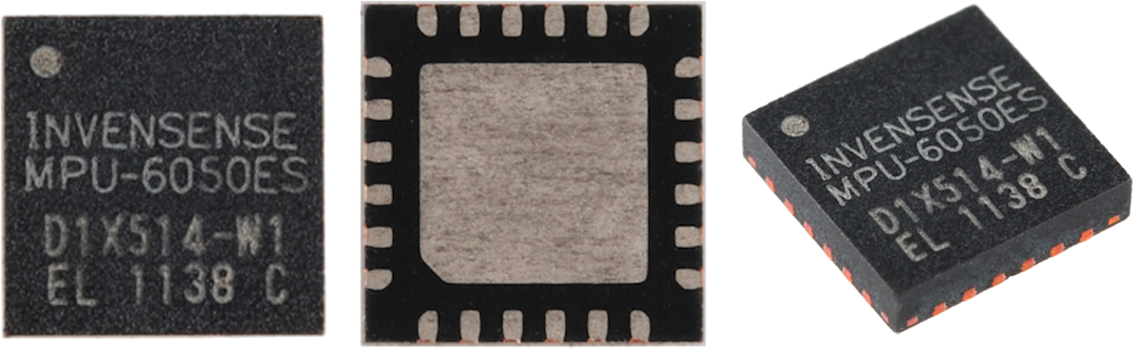
QFN

Slide 17
DESIGN FLOW SCHEMATIC LAYOUT DRC/ERC PANELIZING CAM JOB GERBER GERBER VIEWER MAIL!.

Slide 18
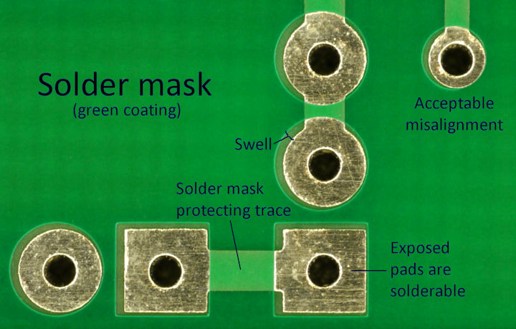
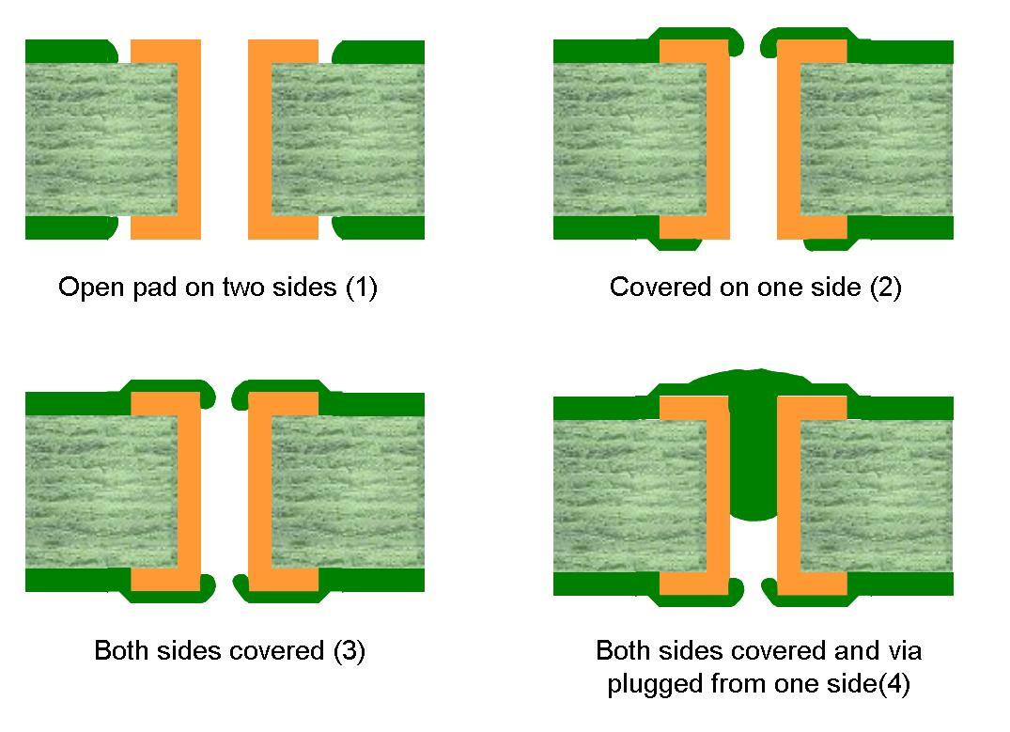
VIAS

Slide 19
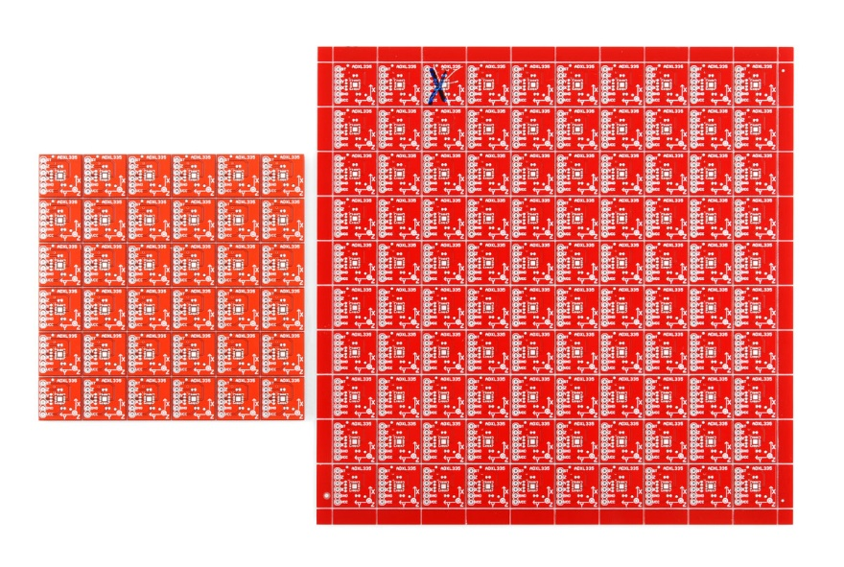

Slide 20
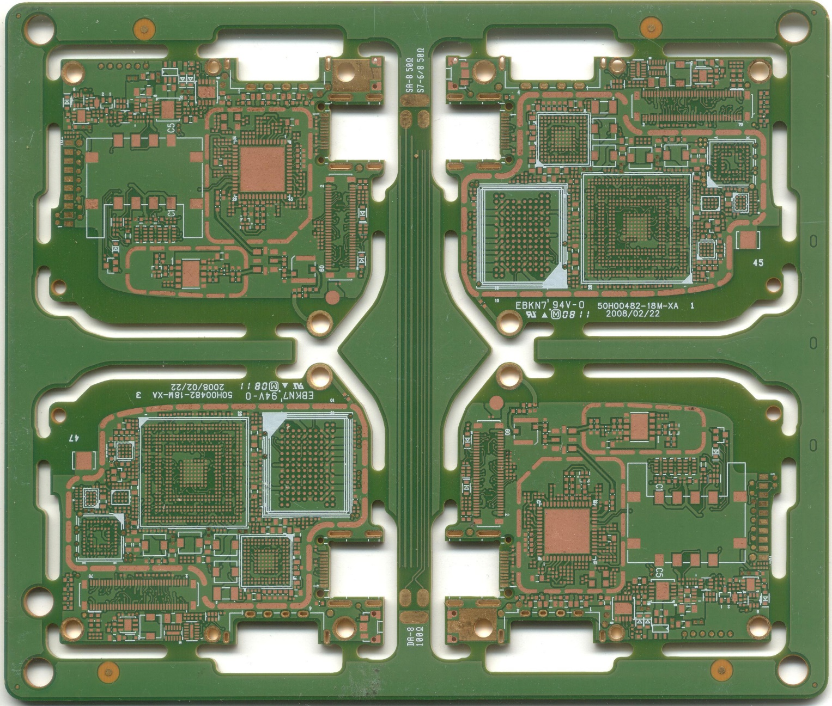
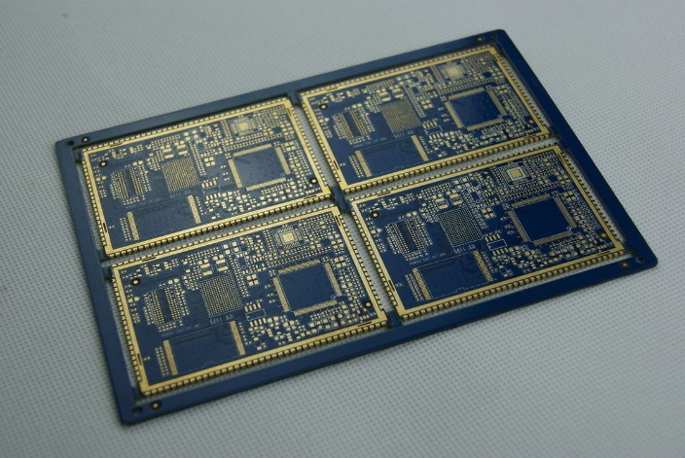

Slide 21
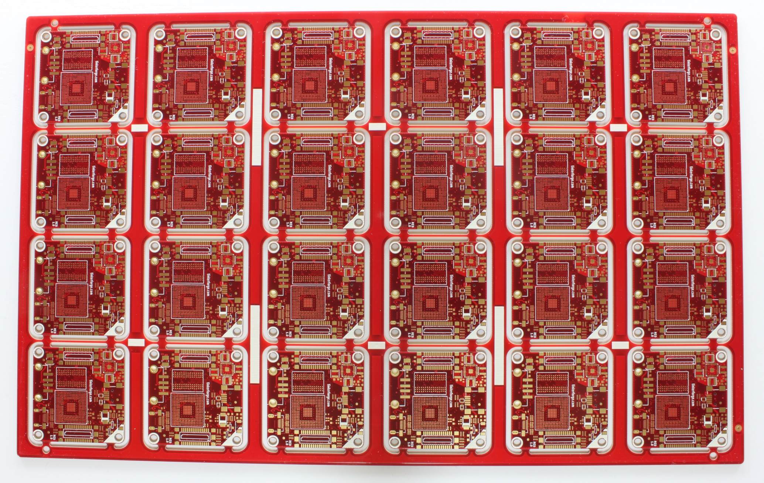
PANELS

Slide 22
BEGIN NEW LIBRARY PART
CC1310

Slide 23

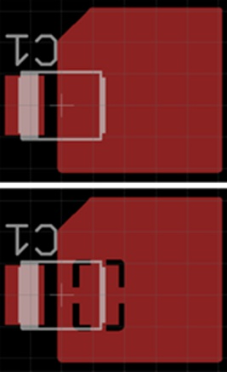
POLYGON POURS THERMAL

Slide 24
Gerber Viewer (sudo apt-get install gerbv)
Sparkfun Pro-Micro design files (Github)
Sparkfun Eagle Library (Github)
Visit the post on Electronics club page and download the folder shared on google drive

